Slide 1
Computer Vision
Lecture-1 (8th Aug 2022)

Slide 2
Grading scheme:
Item | Weightage
Midterm | 20%
Endterm | 40%
Quiz | 20%
Matlab task/ Assignment | 10%

Slide 3
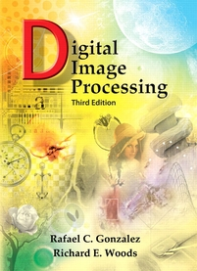
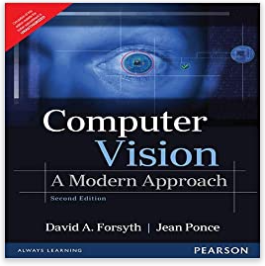
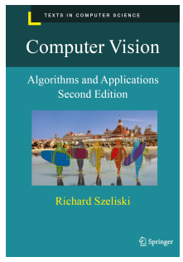
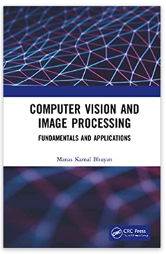
Textbooks
1. Digital Image Processing
Rafael C. Gonzalez and Richard E. Woods, Pearson Education, 3rd edition
2. Forsyth & Ponce, “Computer Vision-A Modern Approach”, Pearson Education.
3. M.K. Bhuyan , “ Computer Vision and Image Processing: Fundamentals and Applications”, CRC Press
4. Computer Vision: Algorithms and Applications, 2nd edition, Richard Szeliski

Slide 4
Other References
NPTEL
https://nptel.ac.in/courses/108/103/108103174/
IBM
https://www.ibm.com/in-en/topics/computer-vision
Univ
http://vision.stanford.edu/teaching/cs131_fall2122/index.html
https://www.iitk.ac.in/ee/computer-vision-lab
https://www3.cs.stonybrook.edu/~cvl/
https://www.epfl.ch/labs/cvlab/research/
https://vision.ee.ethz.ch/research.html
http://cvlab.cse.msu.edu/category/research.html

Slide 5
UNIT 1: Introduction
Introduction to Computer Vision and Image Processing
Image Formation Concepts
Geometric Transformations
Image Transforms
Image Enhancement
Image Filtering
Edge detection
Color Image Processing

Slide 6
Computer Vision
What does it mean, to see? The plain man’s answer would be, to know what is where by looking.
To discover from images what is present in the world, where things are, what actions are taking place, to predict and anticipate events in the world.

Slide 7
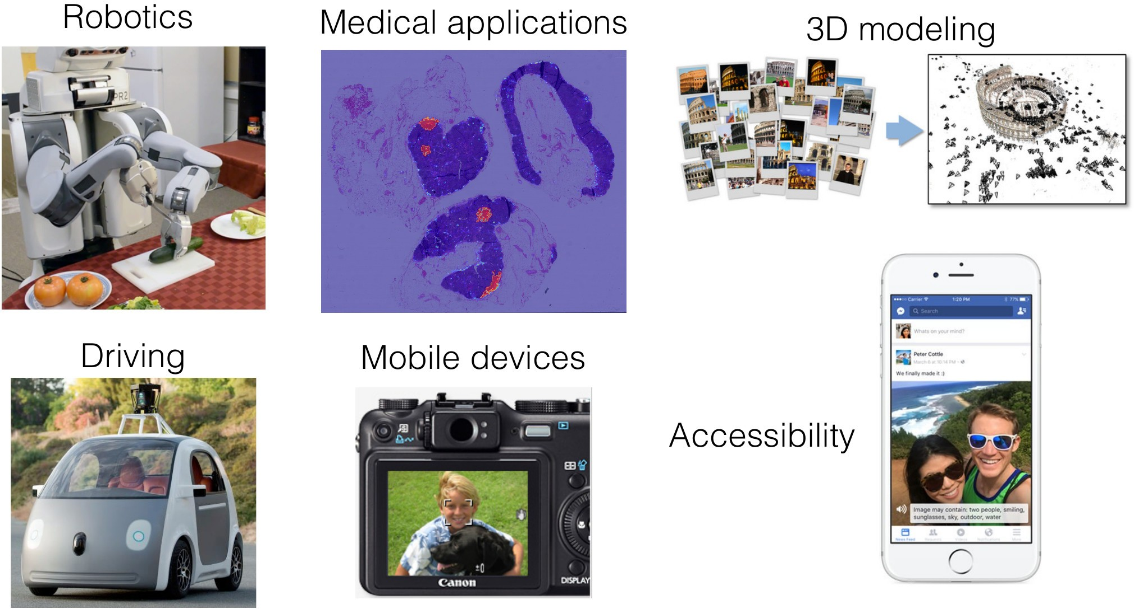
Computer Vision Applications

Slide 8
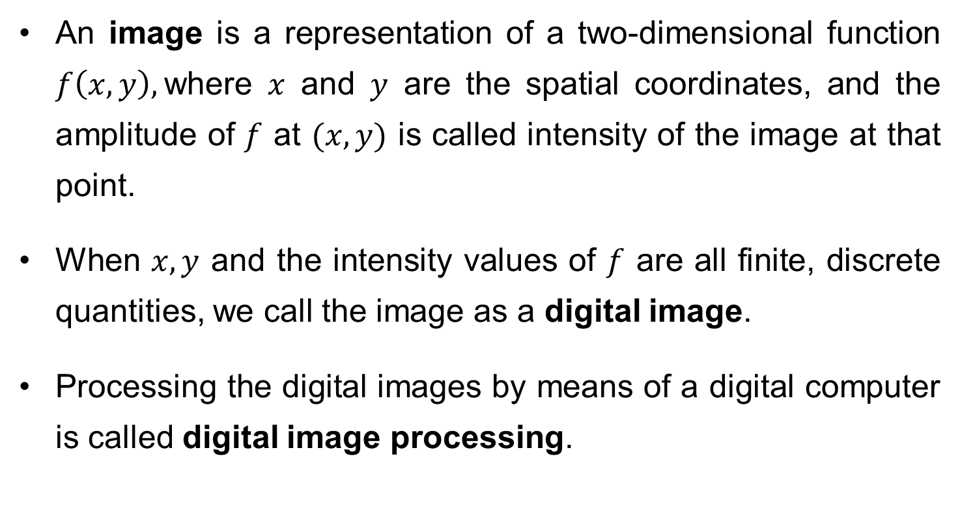
What is a Digital Image?
An image is a representation of a two-dimensional function $f\left(x,y\right),$where $x$ and $y$ are the spatial coordinates, and the amplitude of $f$ at $(x,y)$ is called intensity of the image at that point.
When $x, y$ and the intensity values of $f$ are all finite, discrete quantities, we call the image as a digital image.
Processing the digital images by means of a digital computer is called digital image processing.

Slide 9

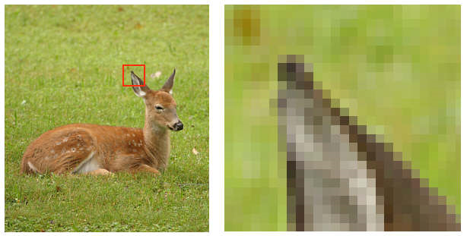
cont…
A digital image is composed of finite number of elements, each having location and value. These elements are called pixels/picture elements.
1 pixel

Slide 10
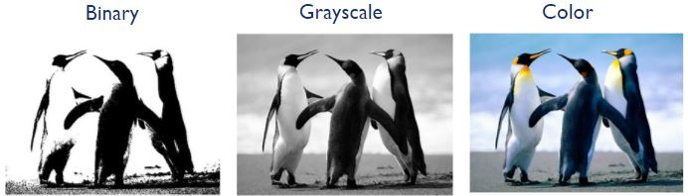
cont…
Common image formats include:
1 sample per point (B&W/binary, Grayscale)
3 samples per point (Red, Green, and Blue)

Slide 11
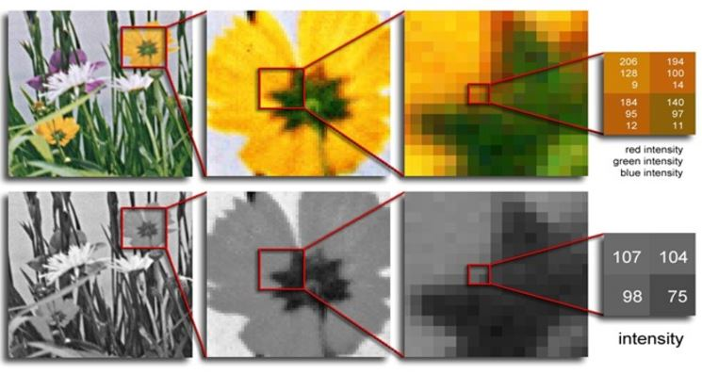
cont…

Slide 12
Key Stages in an Image Processing
Image Restoration
Morphological Processing
Image Enhancement
Segmentation
Image Acquisition
Representation & Description
Object Recognition
Problem Domain
Colour Image Processing
Image Compression

Slide 13

Image Acquisition
Image Restoration
Morphological Processing
Image Enhancement
Segmentation
Image Acquisition
Representation & Description
Object Recognition
Problem Domain
Colour Image Processing
Image Compression

Slide 14
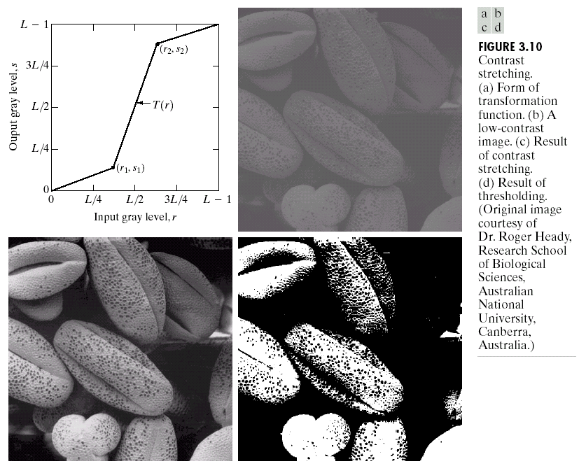
Image Enhancement
Image Restoration
Morphological Processing
Image Enhancement
Segmentation
Image Acquisition
Representation & Description
Object Recognition
Problem Domain
Colour Image Processing
Image Compression

Slide 15
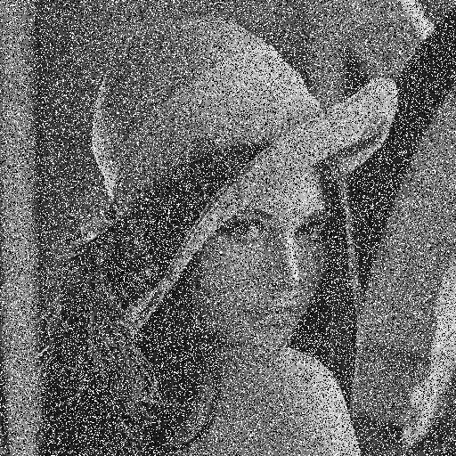
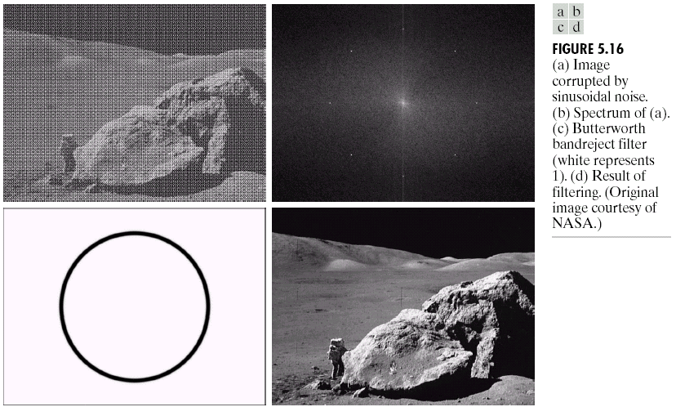
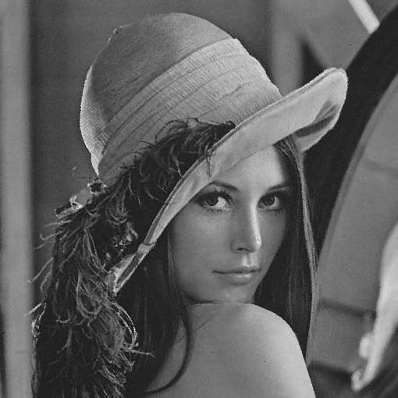
Image Restoration
Image Restoration
Morphological Processing
Image Enhancement
Segmentation
Image Acquisition
Representation & Description
Object Recognition
Problem Domain
Colour Image Processing
Image Compression

Slide 16



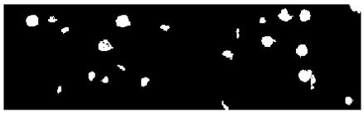
Morphological Processing
Image Restoration
Morphological Processing
Image Enhancement
Segmentation
Image Acquisition
Representation & Description
Object Recognition
Problem Domain
Colour Image Processing
Image Compression

Slide 17
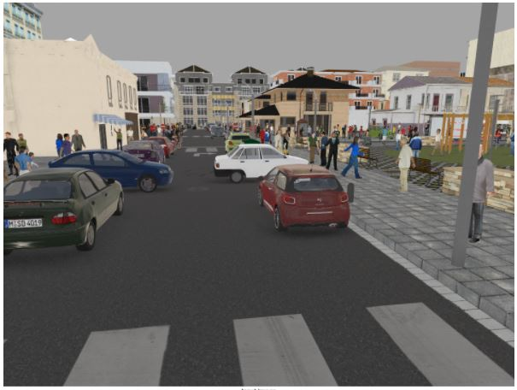
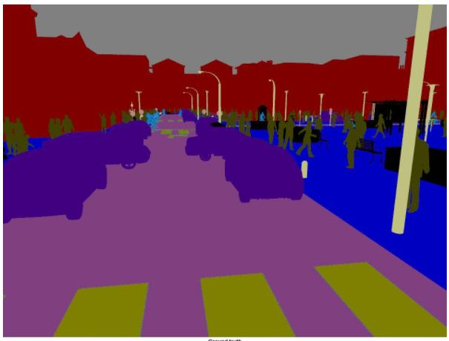
Segmentation
Image Restoration
Morphological Processing
Image Enhancement
Segmentation
Image Acquisition
Representation & Description
Object Recognition
Problem Domain
Colour Image Processing
Image Compression

Slide 18
Representation & Description
Image Restoration
Morphological Processing
Image Enhancement
Segmentation
Image Acquisition
Representation & Description
Object Recognition
Problem Domain
Colour Image Processing
Image Compression

Slide 19
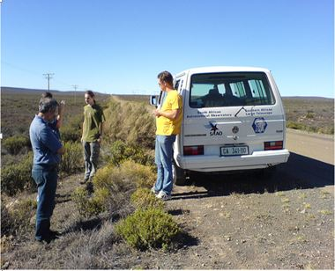
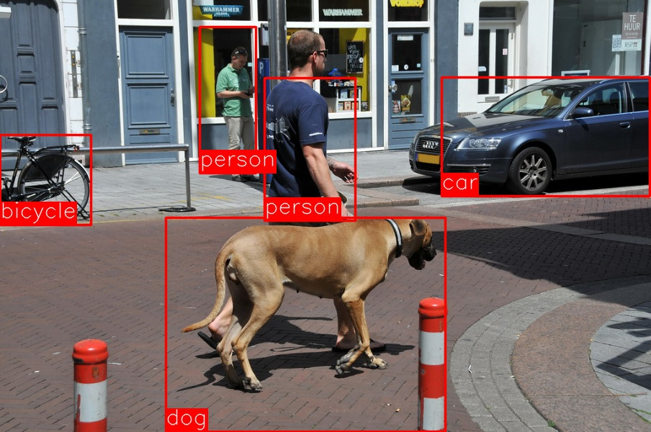
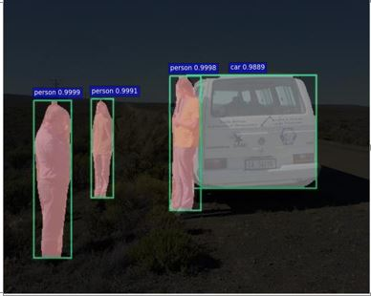
Object Recognition
Image Restoration
Morphological Processing
Image Enhancement
Segmentation
Image Acquisition
Representation & Description
Object Recognition
Problem Domain
Colour Image Processing
Image Compression

Slide 20
Image Acquisition Process
View at lens focal plane

Slide 21
Why digitization??
A continuous image is represented by infinite number of points.
Each point may have one of the infinitely many possible intensity value. This will need infinite number of bits to represent the color.
Therefore, such representation is not possible in any digital computer.

Slide 22
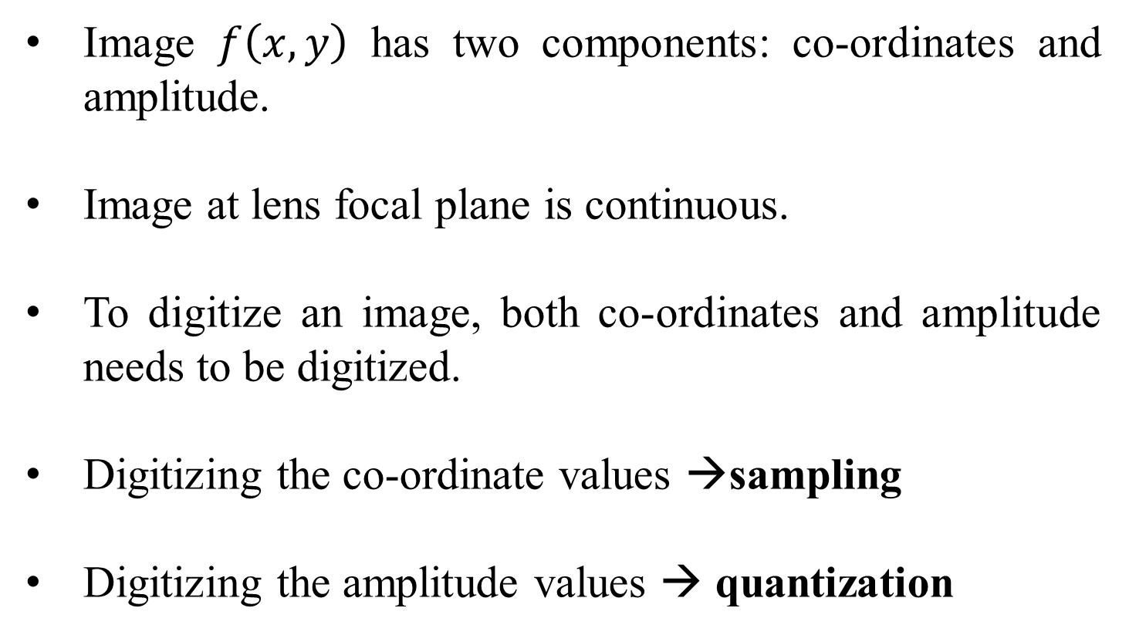
Image Sampling and Quantization
Image $f\left(x,y\right)$ has two components: co-ordinates and amplitude.
Image at lens focal plane is continuous.
To digitize an image, both co-ordinates and amplitude needs to be digitized.
Digitizing the co-ordinate values →sampling
Digitizing the amplitude values → quantization

Slide 23
Sampling
The co-ordinate values of a continuous image is digitized as a 2-D matrix.
where M → finite rows and N→ finite columns

Slide 24
Quantization
Intensity → digitized
Quantization levels/gray levels (L)
How many quantization levels can we have?

Slide 25
How many quantization levels can we have?
Quantization levels→ [0, L-1]
L=2^{k}
k →no. of bits per channel

Slide 26
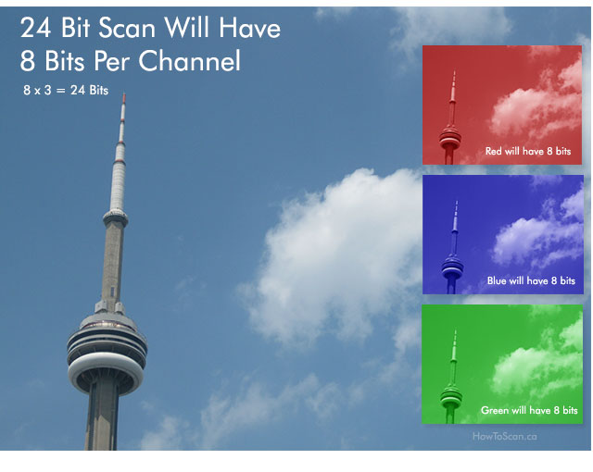
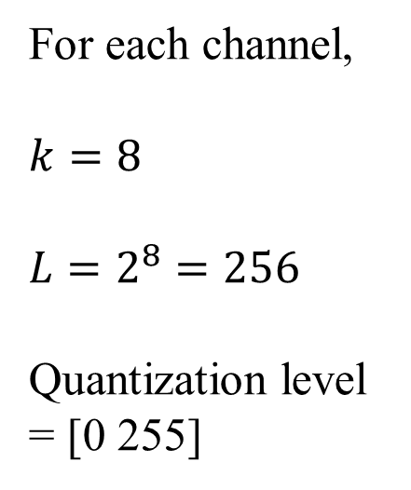
Example
For each channel,
$$k=8$$
$$L=2^{8}=256$$
Quantization level = [0 255]

Slide 27
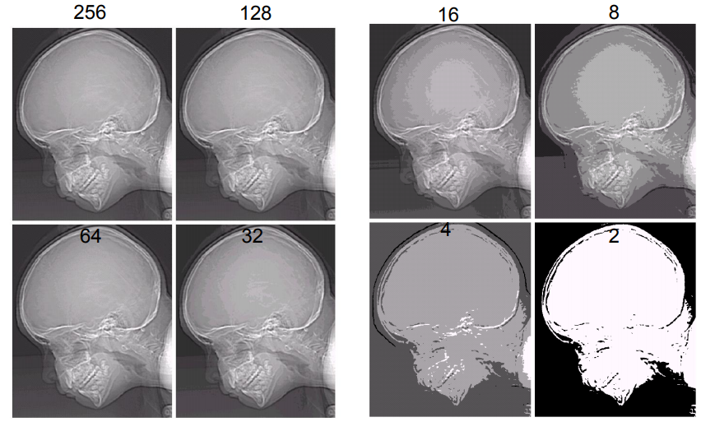
Images with varying intensity levels ‘L’

Slide 28
The number ‘b’ of bits required to store a M × N digitized image
b = M × N × k
k representing k bit image

Slide 29
Basic relationships between pixels
Neighborhood
Connectivity
Adjacency
Paths
Regions and boundaries

Slide 30
Neighborhood
Neighbors of a pixel p at coordinates (x,y)
4-neighbors of p, denoted by N₄(p):
(x-1, y), (x+1, y), (x,y-1), and (x, y+1).
4 diagonal neighbors of p, denoted by N_{D}(p):
(x-1, y-1), (x+1, y+1), (x+1,y-1), and (x-1, y+1).
8 neighbors of p, denoted N₈(p)
N₈(p) = N₄(p) U N_{D}(p)

Slide 31
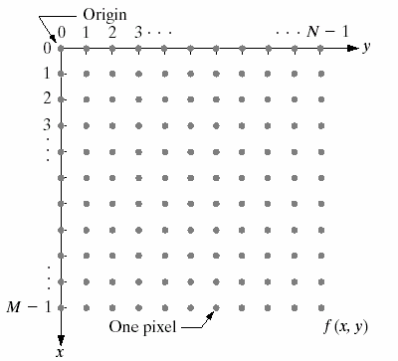
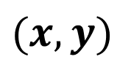
$$(x,y)$$

Slide 32
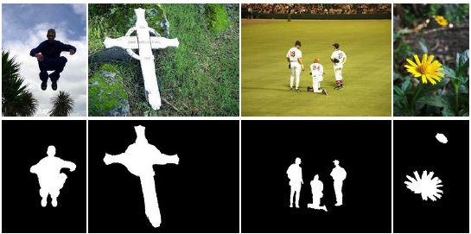
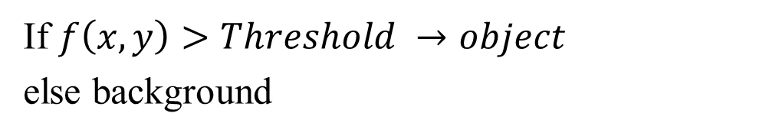
Connectivity
If $f\left(x,y\right)>Threshold →object$
else background
Obj 1
Obj 2

Slide 33
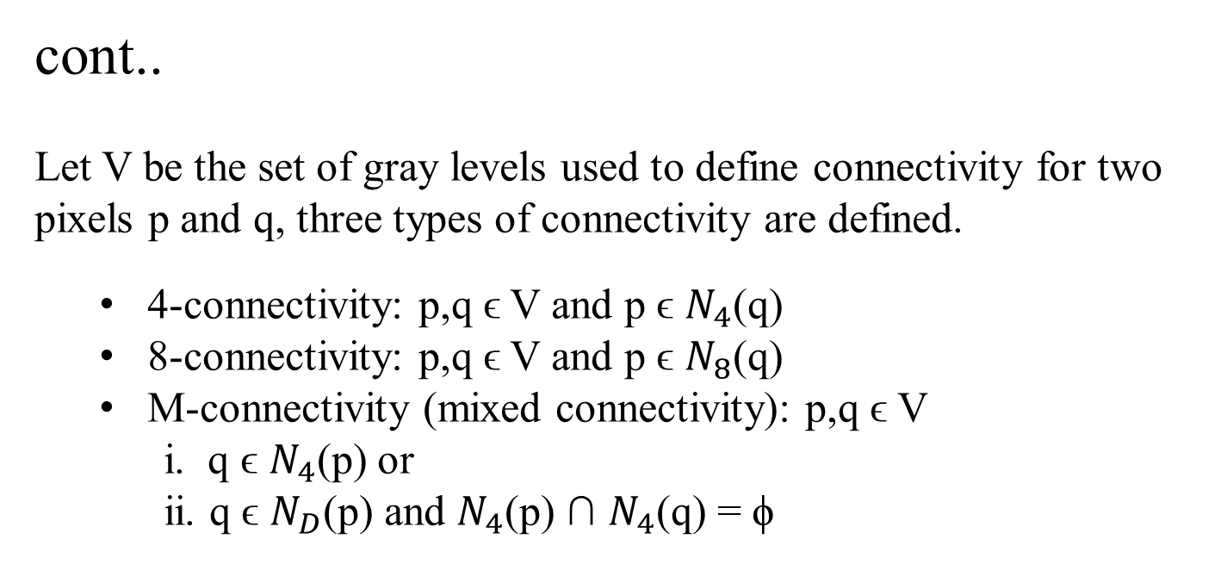
cont..
Let V be the set of gray levels used to define connectivity for two pixels p and q, three types of connectivity are defined.
4-connectivity: p,q ϵ V and p ϵ $N_{4}$(q)
8-connectivity: p,q ϵ V and p ϵ $N_{8}$(q)
M-connectivity (mixed connectivity): p,q ϵ V
i. q ϵ $N_{4}$(p) or
ii. q ϵ $N_{D}$(p) and $N_{4}$(p) ∩ $N_{4}$(q) = ϕ
Eg. V={1}
0 | 1 | 1
0 | 1 | 0
0 | 0 | 1
0 | 1 | 1
0 | 1 | 0
0 | 0 | 1
0 | 1 | 1
0 | 1 | 0
0 | 0 | 1
q
p
4-connectivity
8-connectivity
M-connectivity

Slide 34
M-connectivity avoids multi path connections that often arise with 8-connectivity.

Slide 35
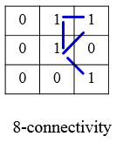
Path
A (digital) path (or curve) from pixel p with coordinates (x₀, y₀) to pixel q with coordinates (x_{n}, y_{n}) is a sequence of distinct pixels with coordinates
(x₀, y₀), (x₁, y₁), …, (x_{n}, y_{n})
where (x_{i}, y_{i}) and (x_{i-1}, y_{i-1}) are adjacent for 1 ≤ i ≤ n.
Here n is the length of the path.
If (x₀, y₀) = (x_{n}, y_{n}), the path is closed path.
We can define 4-, 8-, and m-paths based on the type of adjacency used.
p
q

Slide 36
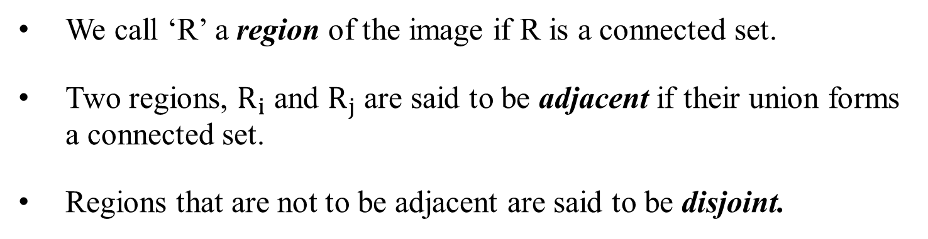
Region & Adjacency
We call ‘R’ a region of the image if R is a connected set.
Two regions, $R_{i}$ and $R_{j}$ are said to be adjacent if their union forms a connected set.
Regions that are not to be adjacent are said to be disjoint.
1 | 1 | 1
1 | 0 | 1
0 | 1 | 0
0 | 0 | 1
1 | 1 | 1
1 | 1 | 1
Region 1
8-adjacency
4-adjacency
8-adjacency
m-adjacency
Region 2

Slide 37
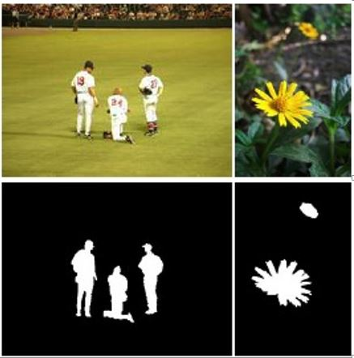
disjoint
Object 2
Object 3
Black- background
White- foreground
Object 1
Object 2
Object 1
Once connected regions are obtained, many properties of those regions can be obtained such as boundary, area, etc.

Slide 38
Boundary
The boundary of the region R is the set of pixels in the region that have one or more neighbors that are not in R (background).
0 | 1 | 0 | 0 | 0
1 | 1 | 1 | 0 | 0
0 | 1 | 1 | 1 | 0
0 | 1 | 1 | 1 | 1
1 | 1 | 1 | 1 | 0
0 | 1 | 0 | 0 | 0
Black- background
White- foreground
8 - connectivity

Slide 39
0 | 1 | 0 | 0 | 0
1 | 1 | 1 | 0 | 0
0 | 1 | 1 | 1 | 0
0 | 1 | 1 | 1 | 1
1 | 1 | 1 | 1 | 0
0 | 1 | 0 | 0 | 0
Black- background
White- foreground
8 - connectivity
4 - connectivity
MATLAB: B = bwboundaries (binary_image,connectivity)

Slide 40
Distance Measures
Given pixels p, q and z with coordinates (x, y), (s, t), (u, v) respectively, the distance function D has following properties:
D(p, q) ≥ 0 [D(p, q) = 0, iff p = q]
D(p, q) = D(q, p)
D(p, z) ≤ D(p, q) + D(q, z)

Slide 41
Euclidean Distance
The Euclidean Distance between p and q is defined as:
D_{e} (p,q) = [(x – s)² + (y - t)²]^{1/2}
D_{e} (p,q)
q (s,t)
p (x,y)

Slide 42
City-Block Distance
The D₄ distance (also called city-block distance) between p and q is defined as:
D₄ (p,q) = | x – s | + | y – t |
q (s,t)
D₄
p (x,y)

Slide 43
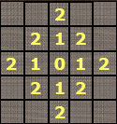

Pixels having a D₄ distance from (x,y), less than or equal to some value r form a Diamond centered at (x,y).
say $r≤2$
(x,y)

Slide 44
Chessboard Distance
The D₈ distance (also called chessboard distance) between p and q is defined as:
D₈ (p,q) = max(| x – s |,| y – t |)
q (s,t)
D_{8(b)}
p (x,y)
D_{8(a)}
D₈ = max(D_{8(a) ,} D_{8(b)})

Slide 45
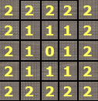
Pixels having a D₈ distance from (x,y), less than or equal to some value r form a square centered at (x,y).
say $r≤2$
(x,y)

Slide 46
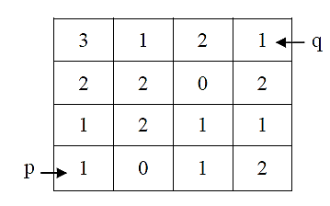
Q.
Let V={0, 1}. Compute the lengths of the shortest 4-path, 8-path and m-path between ‘p’ and ‘q’ shown in figure below. Also show the path formed. What is the value of Chessboard distance and City block distance

Slide 47
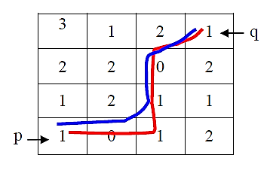
Ans:
When V={0, 1}, 4-path does not exist.
The shortest 8-path has length = 4 (as shown in blue line) and the shortest m-path has length = 5 (as shown in red line).
Chessboard distance : 3
City block distance : 6

Slide 48
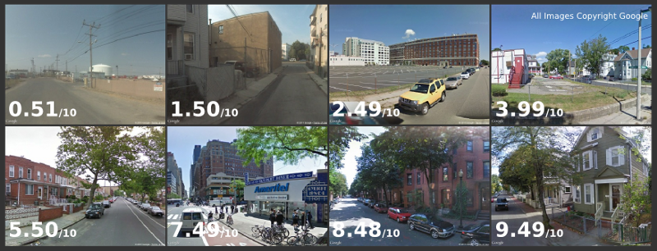
2014-15 Streetscore
The typical high scoring image contains suburban houses with manicured lawns and streets lined with trees; while the typical low scoring image contains empty streets, fences, and industrial buildings.

Slide 49
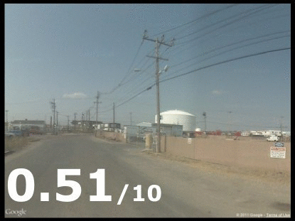

Slide 50
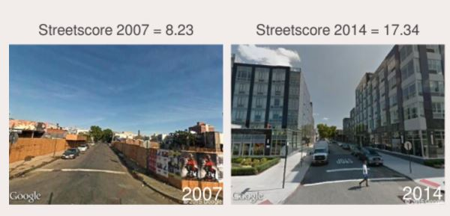
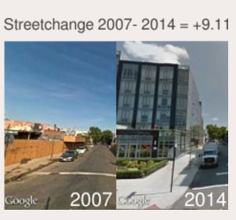
2016-17
Streetchange

Slide 51
https://www.media.mit.edu/projects/seeing-through-walls-computer-vision/overview/
https://www.media.mit.edu/projects/looking-around-corners/overview/
https://www.youtube.com/watch?v=JWDocXPy-iQ
https://www.media.mit.edu/

Slide 52
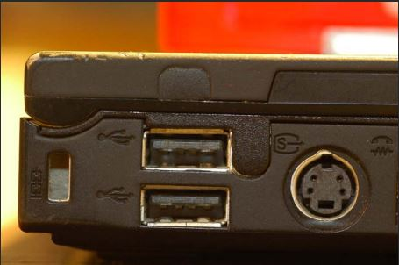
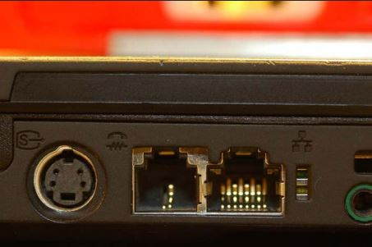
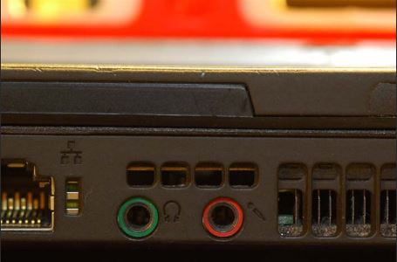
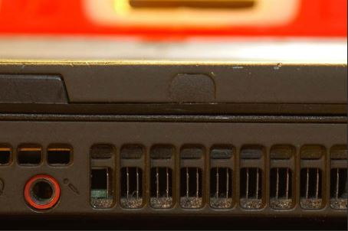
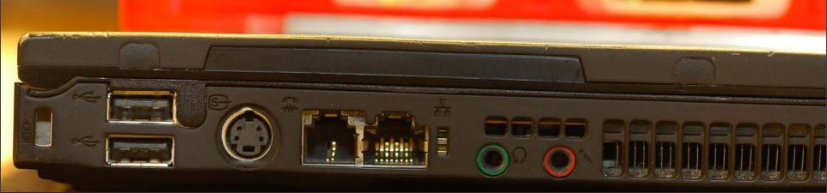

Slide 53
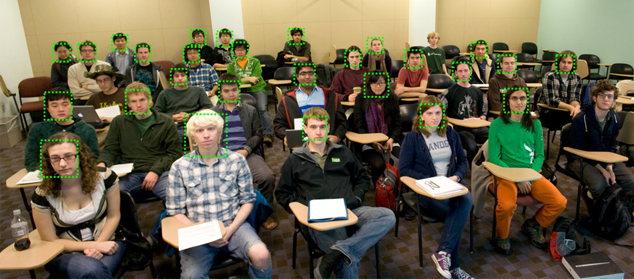
Face detection in a classroom

Slide 54
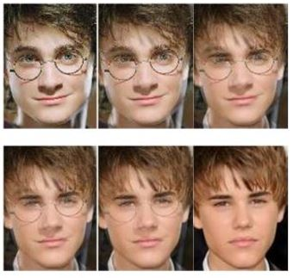
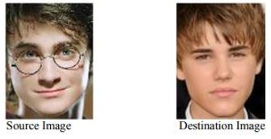
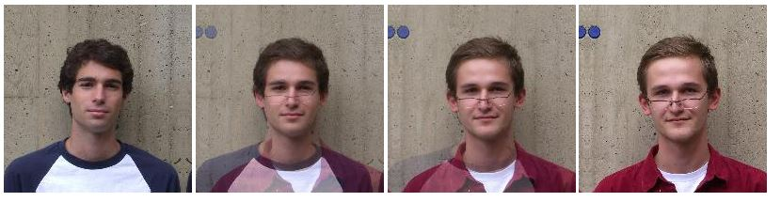
Image morphing

Slide 55
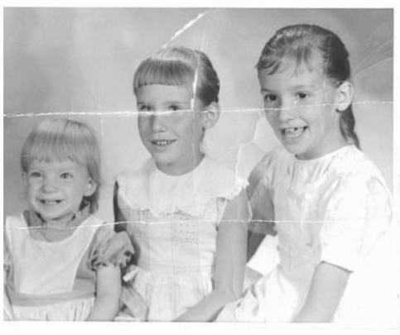

Image Inpainting 1

Slide 56
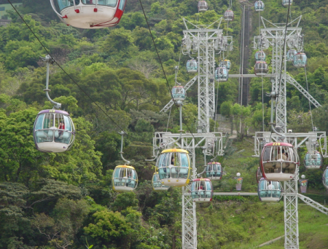

Image Inpainting 2

Slide 57
Smile detection

Slide 58

Biometrics

Slide 59

Activity recognition

Slide 60





